Slide 1
SUPPER PROGRAM FOR ASP STAFF
2024-2025

Slide 2
Annual Training
FSD is required to provide annual CACFP supper training to all Food Services (FS) and After School Program (ASP) staff before the start of every school year, new program Saturday program, and to new employees.
Notes:
TELL: FSD is required to provide annual CACFP supper training to all Food Services (FS) and After School Program (ASP) staff before the start of every school year, implementation of a new program, and to new employees.

Slide 3
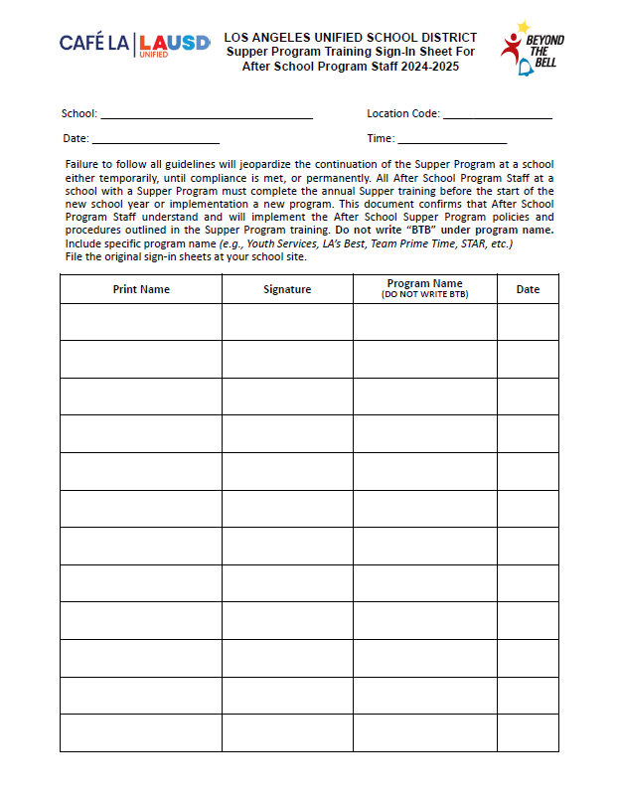
ASP Training Sign in Sheet
ASP staff must be trained prior to working the Hot Supper or Saturday Program
1st day of school is August 12th
A copy will be given to ASP staff for their records.
Do not write BTB
Notes:
TELL: This is the Supper Program Training Sign-In Sheet for ASP staff. All ASP staff must be trained prior to working the Hot Supper Program. Ensure that the specific program name is listed in the program name column. Then, file original sign-in sheets at your school site and give a copy to ASP staff for their records.

Slide 4
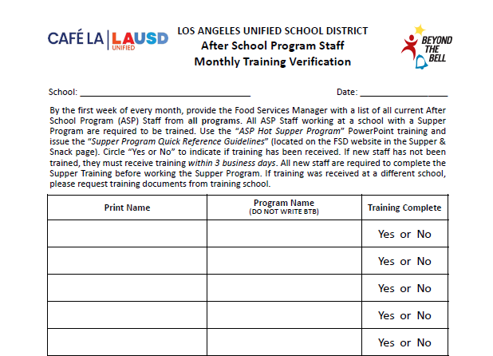
ASP Staff Training Verification
Happy Elementary
10/18/2024
Due to regular ASP staff turnover, complete the ASP Staff Monthly Training Verification.
Names will be compared with Supper Program Training Sign-In Sheets
John Miller
Youth Services
Elizabeth Lee
LA’s Best
George Wilson
LA’s Best
Ann Davis
STAR
Michelle Susette
Boys & Girls Club
Do not write BTB
Notes:
TELL: Due to regular ASP staff turnover, complete the ASP Staff Monthly Training Verification. Upon collection, compare names with Supper Program Training Sign-In Sheets. Next, identify any staff in need of training, then provide training for new staff. Please note that all staff must be trained prior to working in the Hot Supper program.

Slide 5
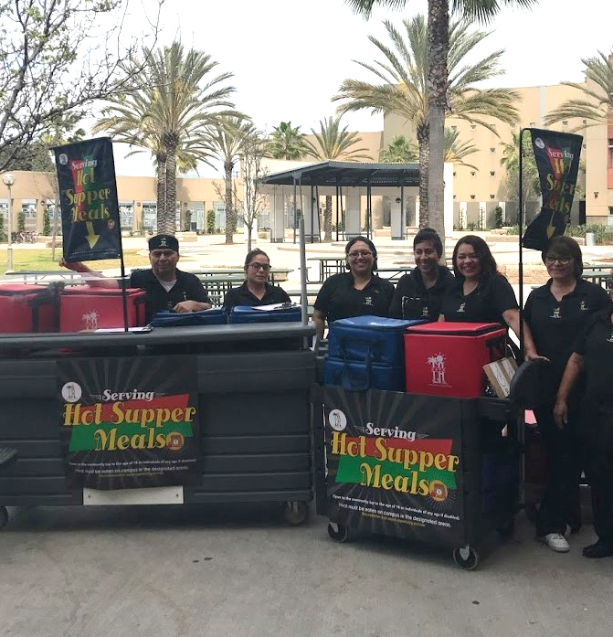
Civil Rights Requirements
All operating sites are required to ensure:
Equal treatment for all participants
Good customer service to decrease complaints
Illegal barriers that prevent participants from receiving benefits are eliminated
“And Justice for All” poster is displayed where the general public can see and read it
General public is informed of program availability
Provide information in the appropriate language
Notes:
TELL: Let’s review the Civil Rights Requirements. All operating sites are required to ensure: equal treatment for all participants, good customer service to decrease complaints, illegal barriers that prevent participants from receiving benefits are eliminated, “And Justice For All” poster is displayed where the general public can see and read it, and that the general public is informed of program availability, if necessary, provide information in the appropriate language.

Slide 6
Early Dismissal Policy
Example: Regular dismissal time is at 2:30pm.
Meal service times are contingent upon school dismissal.
Cut-Off Time: | Before 1:00 pm | After 1:00 pm
Rule: | Students are served at the regular dismissal time | Students are served at the early dismissal time
Scenario: | Students are dismissed at 12:50pm | Students are dismissed at 1:20pm
Service Time: | Students are served at *2:30pm | Students are served at 1:20pm
*Exceptions may apply. AFSS approval is required to serve at alternate serving times.
Notes:
TELL: Meal service times are contingent upon school dismissal. Let’s Review the Early Dismissal Policy Chart. Early release days are now categorized into 2 simple categories.
CLICK TELL: If the students are released before 1pm, Hot supper will be served at the regular dismissal time. For example. Let’s say the regular school dismissal is at 2:30pm.
CLICK
TELL: Let’s explore this scenario. Students are released at 12:50 pm.
CLICK
TELL: According to the Early Dismissal policy, Hot Supper will be served at 2:30 pm. Please note that *Exceptions may apply. AFSS approval is required to serve at alternate serving times.
CLICK
TELL: Let’s look at a different scenario. If the students are released earlier then their regular dismissal, but after 1pm. Then Hot supper will be served Immediately after the early dismissal time.
CLICK
TELL: Let’s explore this scenario. Students are released at 1:20 pm.
CLICK
TELL: According to the Early Dismissal policy, Hot Supper will be served at 1:20 pm.

Slide 7
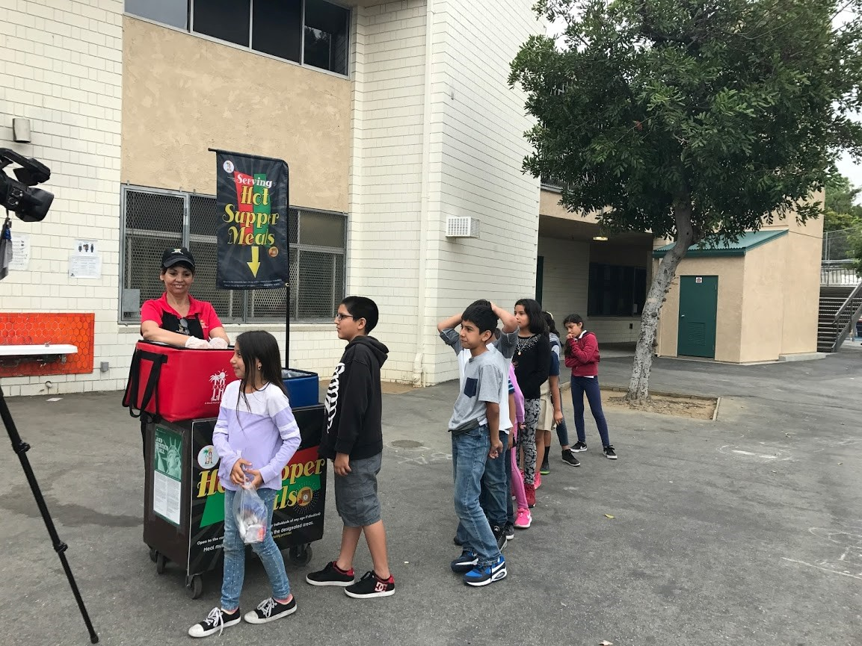
Early Release Students
Service time may be adjusted to accommodate students released before the regular dismissal bell on a regular basis.
These students may include:
Special Education Students
Bussed Students
Other Eligible Programs
Notes:
TELL: Service time may be adjusted to accommodate students released before the regular dismissal bell on a regular basis.
These students include, Special Education students and bussed students, and other eligible programs. Note: Any change in the service time must be included in the Change of Supper Meal Service Form. For example: The school’s dismissal is at 2:30pm, but Special Ed students are released at 2:15pm. Serving time is 2:15-3:00pm.

Slide 8
Chocolate Milk Rule
The CACFP guidelines restricts the serving of chocolate milk to students under the age of six.
Offer unflavored milk to children under six
Children six or older can choose between unflavored or chocolate milk
To ensure compliance, ask children their age if they appear to be less than six years old.
Notes:
TELL: Now let’s talk about chocolate milk. The CACFP guidelines restricts the serving of chocolate milk to students under the age of six. Children under six must be offered unflavored milk. However, children six or older can choose between unflavored or chocolate milk.

Slide 9
Reimbursable Meals
Supper meal service adheres to OVS guidelines.
3 of the 5 meal components must be selected to complete a reimbursable meal.
Student is not required to take a vegetable or fruit during supper

Slide 10
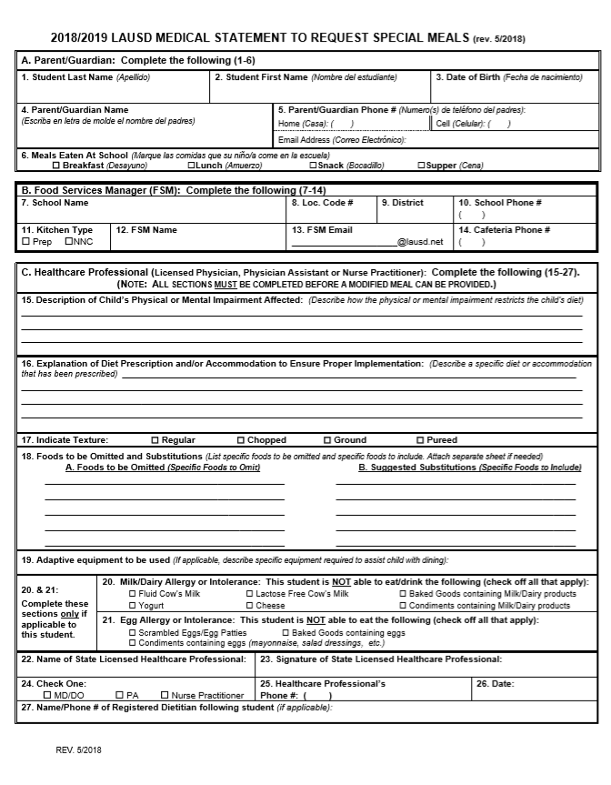
Special Dietary Needs
Students who require a special meal can complete the “Medical Statement to Request Special Diets” form. ASP will:
Provide the form to families for completion by the child’s treating physician
Submit the completed form to the Cafeteria Manager
Notes:
TELL: The Food Services Manager will communicate with FS and ASP staff of any students with food allergies. The Food Service Manager will provide the “Medical Statement to Request Special Diets” to families. The child’s treating physician will need to complete the form. The Food Services Manager will submit the completed “Medical Statement to Request Special Diets” form to the Nutrition Specialists. The manager will make substitutions based on the special diet provided by the Nutrition Specialist.

Slide 11
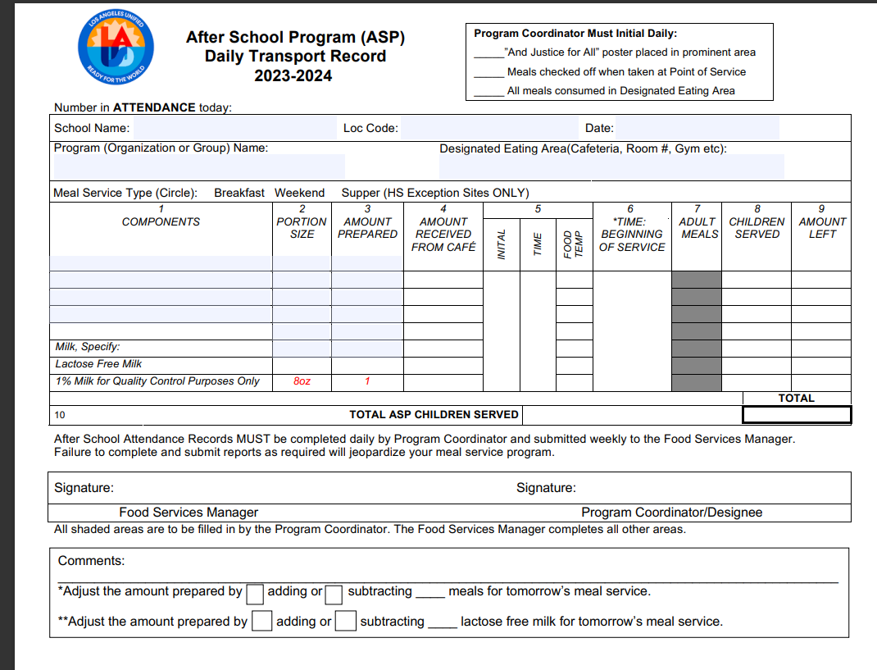
Supper Transport Record
Supper Transport records must be supplied daily to ASP staff.
Manager or Food Service Staff will:
Pre-fill the header with school name, location code, date, ect.
Pre-fill components portion size and amount prepared.
Once received ASP staff will then fill amount received, temp each item and document all counts for meals served.
ASP coordinator must sign at the end of service before returning transport record.
Manager will sign once record is returned. Signifying all fields have been properly filled.

Slide 12
How to spot a Reimbursable Meal

Slide 13
Today’s Menu Items
1 component food items
2 components entrée
Is this a reimbursable meal?

Slide 14
Today’s Menu Items
1 component food items
2 components entrée
Is this a reimbursable meal?

Slide 15
Today’s Menu Items
1 component food items
2 components entrée
Is this a reimbursable meal?

Slide 16
REMINDER
Student is not required to take a vegetable or fruit during supper
3 of the 5 meal components must be selected to complete a reimbursable meal.

Slide 17
Supper Cart Set Up
Because of the OVS model, a supper cart and the BIC dolly may need to be used together to serve supper.
Store food items in BIC insulated bags before service
Use BIC dolly to carry additional bags to supper area on campus
Use the shelf space on cart to store 3lb trays and sporkettes
Highly recommended to set up near a lunch table in the designated eating area.

Slide 18
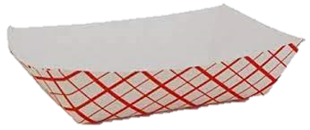
Supper Cart Set Up Example
Your set up may differ according to your participation counts, campus and weekly menu.
Store less popular items in same bag to maximize space
Do not crush or squeeze food items into bags; use an additional bag
This model allows for OVS

Slide 19
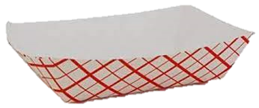
Supper Service Example
Staff must ensure reimbursable meals are served BEFORE recording the meals on the ASP/Community Forms. Meals served that are not reimbursable cannot be claimed.
Notes:
“Staff must ensure reimbursable meals are served BEFORE recording the meals on the ASP/Community Forms. Meals served that are not reimbursable cannot be claimed.”

Slide 20
Counting and Claiming Forms
ASP Supper Grid Sheet
Community Roster
5-Day
1-Day
5-Day
1-Day
Notes:
TELL: Let’s talk about the Counting and Claiming forms. There are 2 versions of the ASP Supper Grid Sheet and the Community Roster: a 5-day and 1-day. Let’s begin with the ASP Supper Grid Sheet.

Slide 21
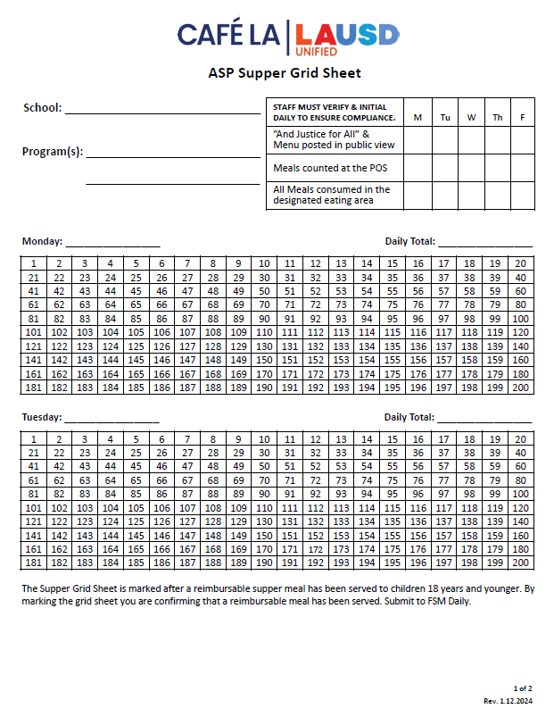
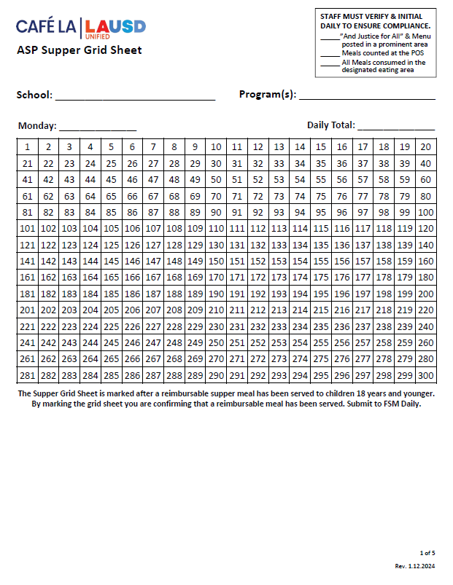
ASP Supper Grid Sheet
These forms record reimbursable meals distributed to the afterschool program students only.
Only trained staff may record meals.
Complete heading, date, and record all programs.
Verify and initial the compliance box daily.
POS staff should focus solely on counting reimbursable meals.
Mark each meal in numerical order with a slash or x AFTER a reimbursable meal is served.
Record total meal counts daily.
Submit to FS Manager daily.
5-Day
1-Day
Notes:
TELL: The ASP Supper Grid Sheet records reimbursable meals distributed to the after school program students only. Only trained FS/ASP staff may record the meals distributed. To begin, complete the heading, date, and record all programs. ASP staff must verify and initial the compliance box daily. To claim meals for reimbursement, confirm meal is reimbursable before marking. Then, mark each meal in numerical order with a slash or X. Lastly, record the total meal counts daily. Remember to collect the ASP Supper Grid Sheet daily.

Slide 22
Community Roster
This form records the attendance and reimbursable meals received by community participants.
Ensure first & last names are written legibly.
FS or ASP Staff ensures a reimbursable meal is selected before names are recorded
Young children may be assisted with writing their names.
A Roster is required at all service locations.
To ensure accuracy in meal accounting, the POS staff should focus solely on counting reimbursable meals
Submit to FS Manager daily.
1 2
Nicole Waterford
Hannah Bankole
Notes:
TELL: The Community Roster records the attendance and reimbursable meals received by community participants. Ensure first and last names are written legibly. Young children may be assisted with writing their names. This form is required at all service locations. Incomplete names listed may be included in the meal count. However, make every effort to obtain the full name at the next supper service. Remember to collect Community Roster daily.

Slide 23
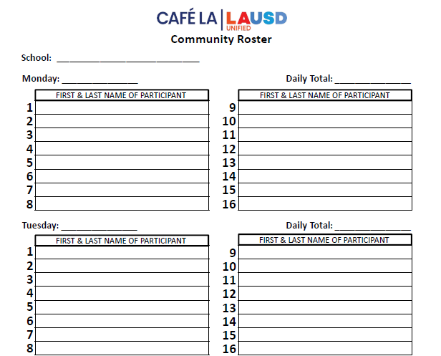
Community Roster Required at ASP Service
Happy El
ASP staff distributes supper meals to program and community participants.
However, some ASP Services do not have any community participants.
10/2/2023
0
ZERO PARTICIPANTS
Is the Community Roster required if
there are no community participants?
10/3/2023
0
ZERO PARTICIPANTS
Yes!
Confirm that the count is zero and file the blank form.
Include the school name and date
Submit to the Food Services Manager daily.
Notes:
TELL: ASP staff distributes supper meals to program and community participants. However, some ASP Services do not have any community participants.
ASK: Is the Community Roster required if there are no community participants?
CLICK
TELL: Yes! Confirm that the count is 0 and file the blank form. Include the school name and date. This blank form must be collected daily.

Slide 24
Meals are prepared by Food Services Staff & are ready for service.
ASP Staff ensures reimbursable meal is received, then marks participant on the appropriate form.
ASP Supper Grid Sheet & Community Roster are required at the point of service.
ASP
SERVICE
Meal service begins immediately after the dismissal bell rings, and lasts for 30 minutes.
Meals are consumed in the designated eating area. No food may leave the campus.
ASP Staff distributes meals to program students & participants from the community.
At least one point of service must be open for the entire 30-minute meal service.
*Exceptions may apply. AFSS approval is required to serve at alternate serving times.
Notes:
TELL: Let’s review the schematic of the ASP service. Meals are prepared by Food Services Staff & are ready for service.
CLICK
TELL: Meal service begins immediately after the dismissal bell rings, & lasts for 30 minutes.
CLICK
TELL: ASP Staff distributes meals to program students & participants from the community.
CLICK
TELL: ASP Staff ensures reimbursable meal is received, then marks participant on the appropriate form. Please note that ASP Supper Grid Sheet & Community Roster are required at the point of service.
CLICK
TELL: Meals are consumed in the designated eating area. No food may leave the campus.
CLICK
TELL: At least one point of service must be open for the entire 30-minute meal service.

Slide 25
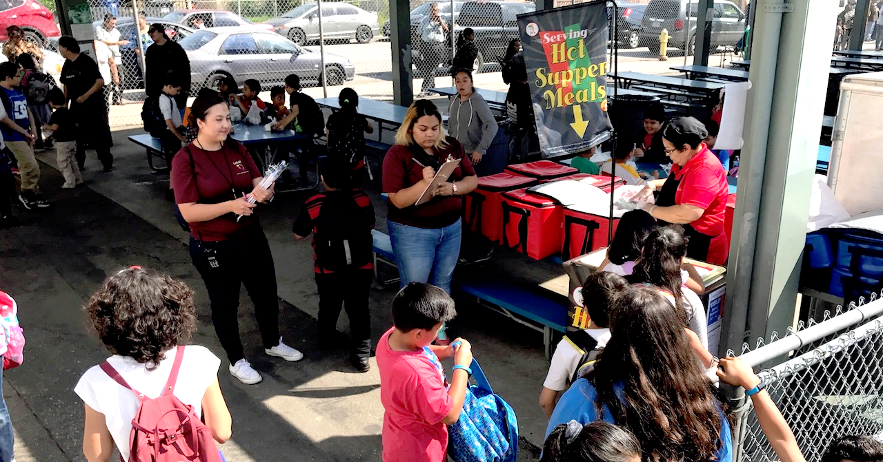
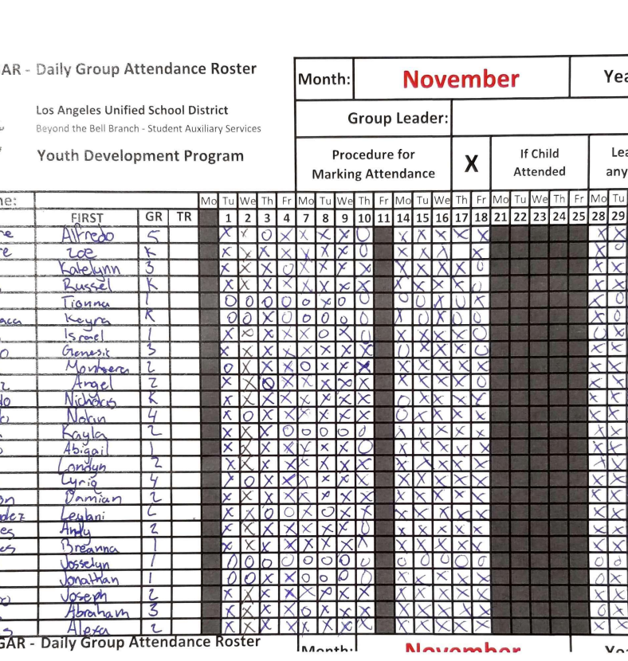
Program Attendance Rosters
Program Attendance Rosters record students present in afterschool programs and support the meal counts on the ASP Supper Grid sheet.
Attendance may be:
Taken before or after meal service
Greater than or equal to meal counts
Meal counts cannot exceed the attendance
BTB must Submit rosters to FSM weekly
Notes:
TELL: Program Attendance Rosters record students present in afterschool programs and support the meal counts on the ASP Supper Grid sheet. Attendance may be: taken before or after meal service, greater than or equal to meal counts. However, meal counts cannot exceed the attendance. These attendance rosters must be submitted to FSM weekly. As pictured, the correct attendance rosters are taken manually by hand.

Slide 26
ASP Staff
Assist with forms at the carts or gates for the first 10 minutes
Distribute meals to program students and/or community
Supervise & direct students to the designated eating area
Make sure program is open to the community, monitor gates
Clean spills, wipe tables, pick up trash & empty bins
Total daily attendance for all programs on the first page

Slide 27
ASP Staff
WILL NOT
Prepare any food items
Push community carts out to designated areas
Remove hot food from warmers or ovens

Slide 28
Saturday Meal
Service
Saturday Meal Service can be classified into two different programs on campus:
Expanded Learning Opportunity Programs (ELOP)(CACFP-supper served)
Instructional(NSL-breakfast and lunch served)
Instructional programs refer to the Saturday Meal Service training for additional information.

Slide 29
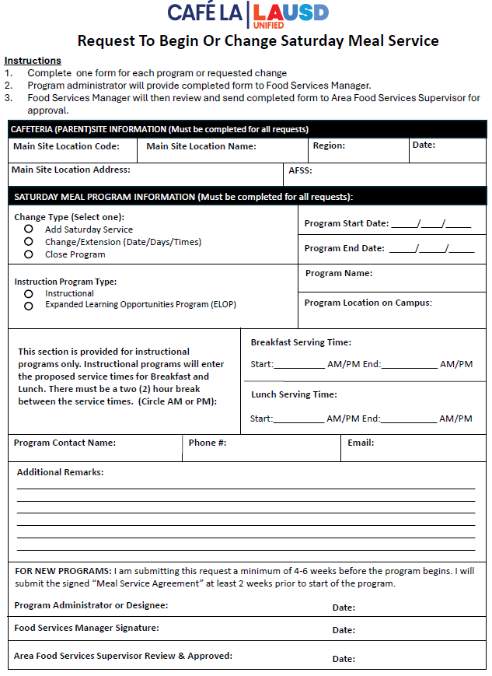
Saturday Meal Service
For Expanded Learning Opportunity Programs
A Request to Begin or Change Saturday Meal Service form must be completed before the start of any Saturday program on site.
Must be submitted 4-6 weeks before the start of the program.
Once completed by the program administrator, form must be signed by the Area Food Services Supervisor.
Notes:
TELL: The ASP Supper Grid Sheet records reimbursable meals distributed to the after school program students only. Only trained FS/ASP staff may record the meals distributed. To begin, complete the heading, date, and record all programs. ASP staff must verify and initial the compliance box daily. To claim meals for reimbursement, confirm meal is reimbursable before marking. Then, mark each meal in numerical order with a slash or X. Lastly, record the total meal counts daily. Remember to collect the ASP Supper Grid Sheet daily.

Slide 30
Saturday Meal Service Checklist
The Saturday Meal Service Checklist is used to ensure Saturday meals are served in compliance to CDE guidelines.
Check list must be completed within the first 4 weeks of the Saturday program by the Saturday program administration.
Notes:
TELL: The Supper Monitoring Scheduler is a tool to ensure monitoring dates are varied per CDE standards. AFSS provides FSM with scheduled monitoring dates. Then, FSM records dates on scheduler as a reminder to complete monitorings.

Slide 31
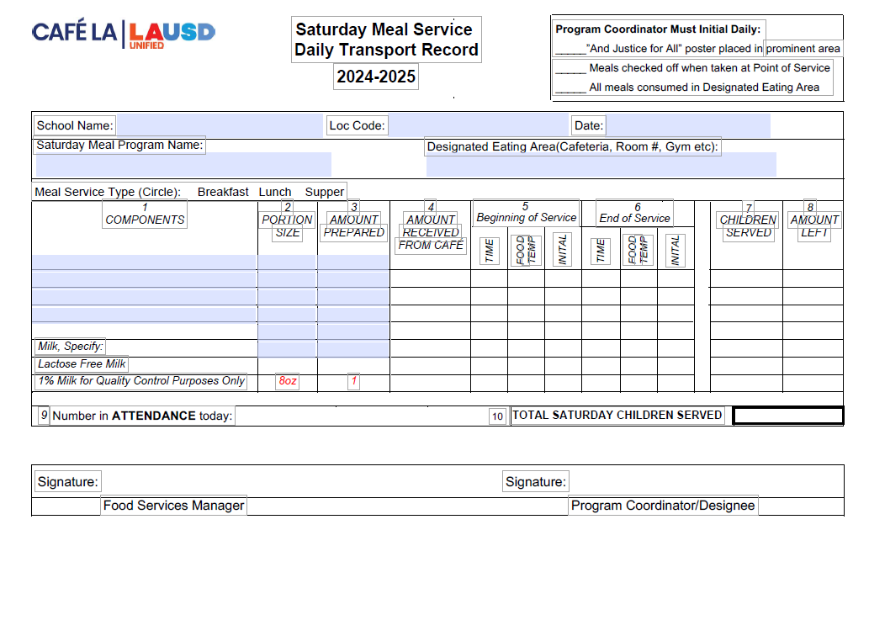
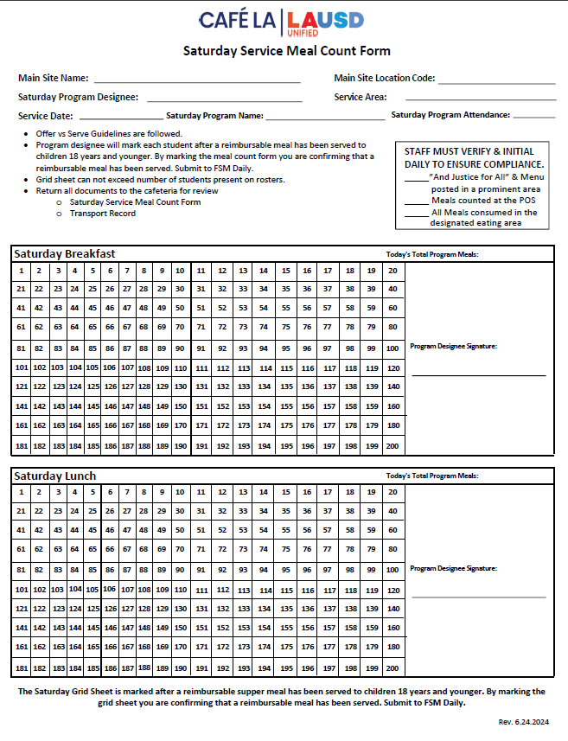
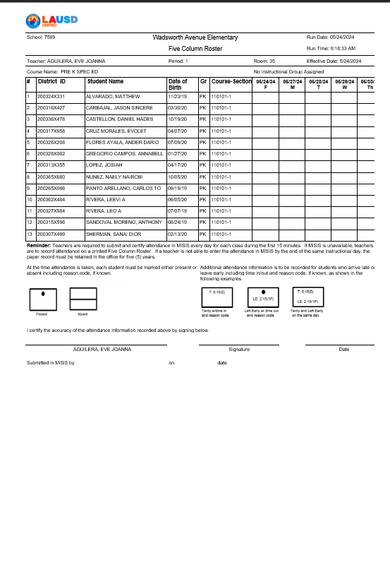
Saturday Meal Service Daily Forms
1
2
Saturday Daily Transport Record
Saturday Service Meal Count Report
3
Saturday Program Attendance Rosters
Notes:
TELL: Here are the six documents required to complete a Supper Monitoring. ASP Supper Grid Sheet, Community Roster, ASP Attendance Roster, FSD and ASP Training Sign-in Sheets, Production Worksheets, and the Food Temperature Log. Any missing documents will result in a deficient monitoring.

Slide 32
Saturday Daily Transport Record
The Saturday Meal Service Daily Transport Record varies from the traditional transport record.
Saturday program staff are required to temp all perishable menu items before and after each meal service, record the temperature on the transport record, initial, then sign.

Slide 33
Saturday Service Overview

Slide 34
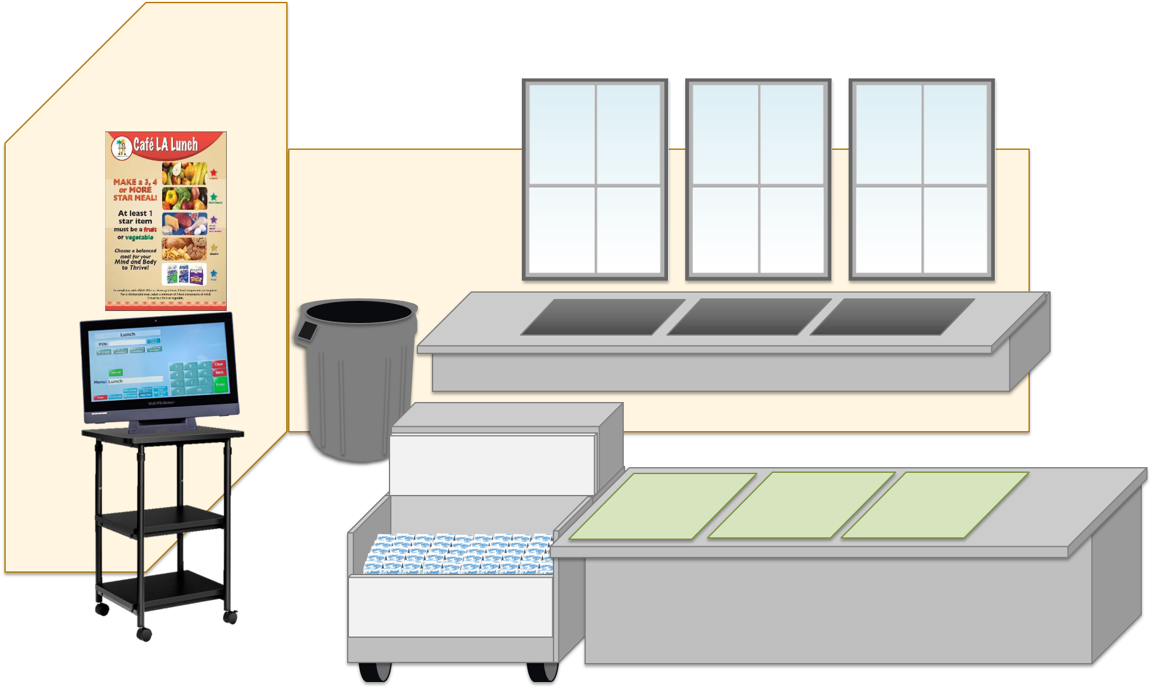
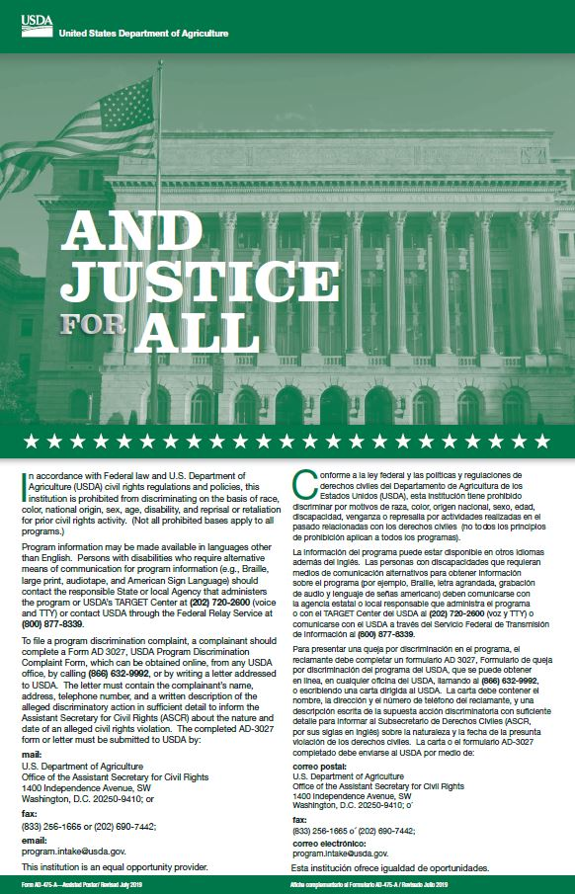
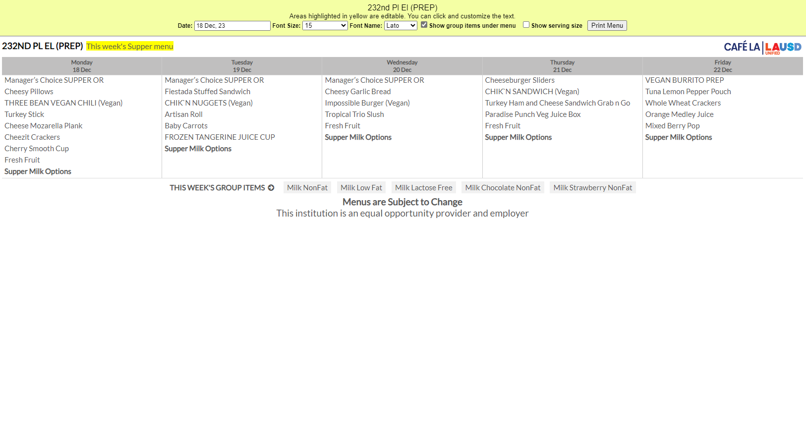
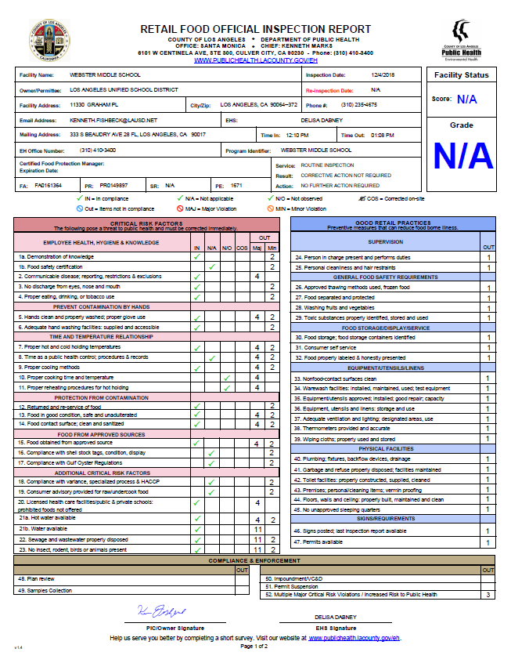
FSM will leave meals for Saturday Service in a refrigeration unit easily accessible to Saturday Program staff

Slide 35
The Next Day
Saturday Program staff will pick up the meals in the designated refrigeration unit.

Slide 36
Saturday Program Staff will return unserved/unused meals to the designated refrigeration unit
After Service
It is important to always return the meals back to the designated refrigeration unit.

Slide 37
`
The Following Monday
Managers will return unused food items back to stock
Its important we all do our part to eliminate waste
But they can’t if everything has spoiled

Slide 38
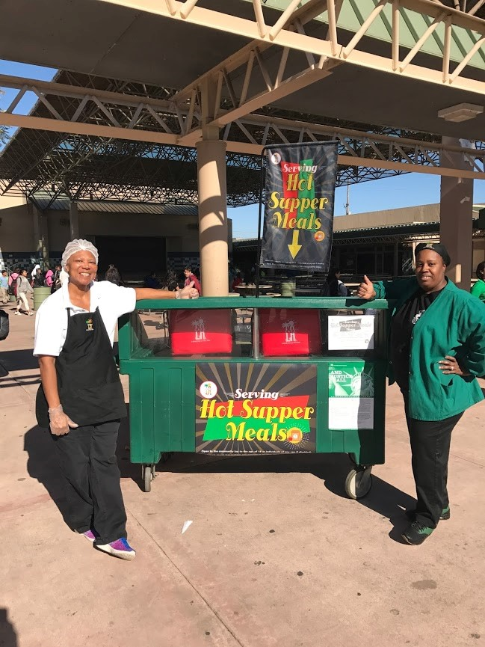
Good Nutrition All Day Long
Providing healthy meals shouldn’t stop once the last bell rings. Often times, parents are still at work when their children get out of school. Serving hot supper meals allows children to receive nutritious meals all day to support their growing bodies and learning needs.
Notes:
TELL: Providing healthy meals shouldn’t stop once the last bell rings. Often times, parents are still at work when their children get out of school. Serving hot supper meals allows the children to receive three nutritious meals a day to support their growing bodies and learning needs. Doing this will ensure that together, we are continuing to provide good nutrition all day long.

